Slide 1
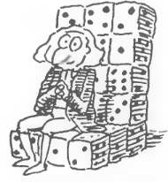
Combinatorial Techniques
Chapter 3 Part 1
Game of Throws
Heads UP: All the answers in this section will be a Natural number
Dr. Abolfazl Saghafi
Assistant Professor of Statistics & Data Science
Data Science Program Director
Notes:
Remember the big picture of Statistics. So far, we learned how to design our study, select a sample, and gather data. Then we learned how to summarize this information and data using various graphs, tables, and numbers. Remember, our goal is the population, we want to make inference about the population using this sample data.
Since we don’t have data from whole population, whatever inference we make has some degree of uncertainty. We need to address this uncertainty in a proper way. We need to learn about the rules to handle it. These rules are probability rules.
But first things first, what is probability, we need to define that as well. Today's lecture is about counting rules, the basic steps we need in order to define probability

Slide 2
Rule #1: Summation Rule (OR RULE)
Suppose that event A can happen in m different ways, event B can happen in n different ways. The two events have o ways of happening in common.
The number of ways events A OR B can happen is m + n - o
Graphing a Venn diagram gives a clear view of the OR operation number of possible ways.
m - o
n - o
o
Notes:
If you’re in doubt, graph this diagram known as the Venn diagram
Pay attention, the red ellipse has m ways in total and the blue ellipse has n ways in total
VERY IMPORTANT: Always start from the intersection, then move out

Slide 3


Examples
Alex & Vicky are trying to figure out the number of guest they invite on their wedding.
Alex wants to invite 25 people, Vicky will invite 175 among whom 5 are in common with Alex’s list. How many guests Alex OR Vicky invite to the ceremony?
In a class of 30 students, 15 are eagles fans and 10 are from New Jersey, if 5 students are both eagles fans and from New Jersey, how many students are Eagles fans OR from New Jersey?
Notes:
15 + 10 – 5 = 20
25 + 175 – 5 = 195

Slide 4
Rule #2: Product Rule (AND RULE)
Suppose that event A can happen in m different ways.
Regardless of the first event, event B can happen in n different ways.
Then the number of ways events A AND B can happen is m * n
A tree diagram gives a visual display of the total number of outcomes in AND rules.

Slide 5



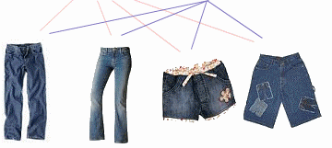



Examples
Assume the only clean clothes you have are 2 t-shirts and 4 pairs of jeans. How many different outfits can you have?
There are three ways to get to city B from A, and two ways to get to city C from B, following these routes, in how many different ways can someone get to city C starting from A?
B
C
A
Independent Selection is important
Notes:
3 * 2 = 6
2 * 4 = 8

Slide 6
Product Rule: Generalization
Example. Mina is ordering pizza for the friends. There are 4 different possible sizes of pizza, 5 toppings, 3 different types of cheese, and 3 different kinds of crust. How many different pizzas can Mina order?
Suppose that events A1 through Ak can happen independently in n1 though nk different ways:
A1 A2 A3 … Ak
n1 n2 n3 … nk
Then, the series of events A1, A2, …, Ak can happen in n1*n2*…*nk different ways.
Example. In how many different ways can we get from A1 to A5?
A2
A3
A4
A5
A1
Notes:
We can generalize the product rule for multiple events happening independently
4*5*3*3 = 180 different pizzas

Slide 7

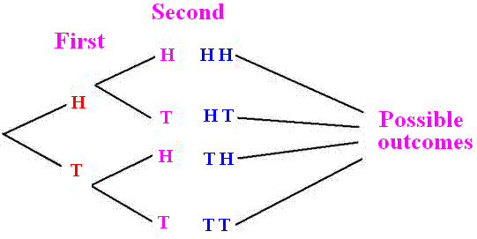
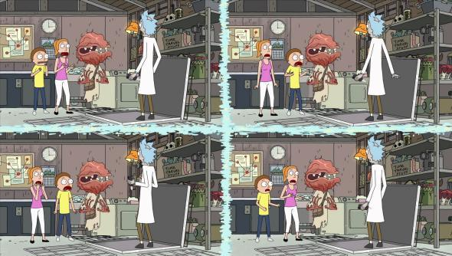
Question
What rule are we using here and why?
A fair coin is tossed twice, how many different outcomes are possible and what are they?
4 different outcome
If we continue tossing to n times, how many different outcomes is possible?
Notes:
We are using product rule here because AND is linking the events, the tree diagram shows all the possible outcomes
It’s like the alternate realities in Rick and Morty!

Slide 8
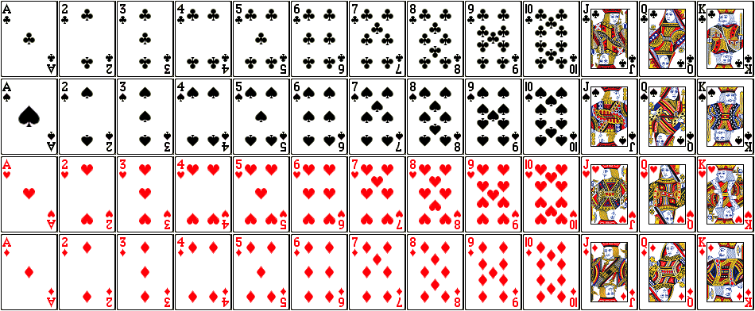

Example
From a deck of cards two cards are selected at random one at a time with replacement. If only the suits are recorded, how many different outcomes are possible?
1
2
52
♠
♥
♠
♦
♣
♠
♥
♥
♦
♣
♠
♦
♥
♦
♣
♣
♠
spade (♠), heart (♥)
diamond (♦) and club (♣)
♥
♦
♣
Notes:
Answer is 4 * 4 =16
Once again, this is a product rule since AND is linking the two draws: “First card suit AND second card suit”

Slide 9
Rule #3: Permutations
The four important characteristics of this rule are shown in different colors.
Suppose out of N distinct objects, k objects are selected at random without replacement, one at a time (order matters).
N
Then the number of possible outcomes is
Repeat
k
times
n=1
1
2
3
…
k-1
k
…
Notes:
The last step is done using product rule

Slide 10
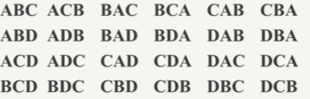
Examples
In how many ways can a sorority of 20 members select a president, vice president and treasury, assuming that the same person cannot hold more than one office.
In how many different ways can you permute 3 out of 4 letters {A, B, C, D}?
1st
2nd
3rd
President
Vice president
Treasury
In how many of them Tina is the President?
Notes:
4 * 3 * 2 = 24
Since we are choosing offices, which is a way to rank members, that means order is important. So we can use permutations here, therefore number of possible ways is 20 * 19 * 18
In 19*18 of them Tina is the president since the first spot is fixed

Slide 11
Especial Case: Factorial
If we select all N objects, one at a time, till the last one, then the number of possible outcomes will be
1
2
3
…
N-1
N
…
Read N! as “N factorial”
0! = 1 1! = 1 2! = 2×1
3! = 3×2×1 n! = n×(n-1) ×… ×1
Notes:
6! is then 6*5*4*3*2*1 = 720

Slide 12
Examples
Suppose there are 30 students in the classroom. In how many ways students can exit the classroom if it had only one small door?
In how many ways can someone rearrange 5 books on a shelf?
1
2
3
4
5
Using factorials we can write the number of possible outcomes in a permutation rule as
Notes:
5! = 5 * 4 * 3 * 2 * 1 = 120
30!
With a simple option like that, it is crazy, even a simple incident like that has this huge different possible ways, it is chaos theory

Slide 13
Rule #4: Combinations
The four important characteristics of this rule are shown in different colors.
Suppose out of N distinct objects, k objects are selected at random without replacement, at the same time (order does not matter).
N
altogether
n=k
Then the number of possible outcomes is
Notes:
No product rule here

Slide 14
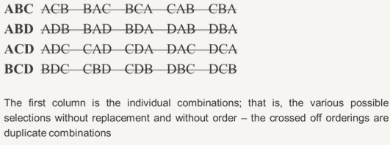

Example
One way to remember this rule is to Partition N distinct objects into two groups, one group with k objects,
the other group with the rest of objects. The total number of possible ways then is
In how many different ways can you combine 3 out of 4 letters {A, B, C, D}?
N distinct objects
k
N - k
$$\frac{N!}{k!\left(N−k\right)!}$$

Slide 15
Examples
Use both pencil and paper and your calculator to do the computations.
Compute the following values
a)
b) c) d)
In how many ways can a sorority of 20 members select three members?
Calculator:
Enter n
MATH > PRB > nCr (or nPr)
Enter r
Enter
Notes:
b) 56 c) d) 12
First compute them by hand, then use your calculator
It’s combination of 3 out of 20 or C(20,3)=1140

Slide 16
Example
Try picturing what is going on and write down the selection steps
We are selecting a team of 3 people from a group of 20 students with 8 females and 12 males. In how many ways we can select
a) these three people without restrictions
b) only one female should be selected
Notes:
a) C(20,3)=1140
b) One female AND Two males are selected, AND is product rule, selection is combination, therfore
C(8,1) * C(12,2) = 8 * 66 = 528
That’s (one female out of 8 females) AND (two males out of 12 males)

Slide 17

Practice Problems Part 1
First compute them BY HAND, then use your CALCULATOR.
1. Seven cards are drawn from an ordinary deck. In how many ways is it possible to draw
a) only 4’s
b) only 6’s, 7’s, and 8’s
c) no 6’s, 7’s, and 8’s
2. Suppose you have 4 shirts, 6 ties and 5 pants, how many different outfits can you have? What rule is used to compute that?
3. How many license plates consist of three digits followed by three letters are possible if repetition allowed? Note: there are ten digits from which to choose each digit from.
Notes:
Answers are provided in Ch3 Practice Problem Solutions
Dogs in Boots Video:
https://www.youtube.com/watch?v=etYwoEOdhD4

Slide 18
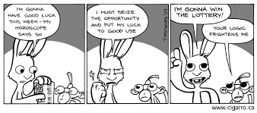
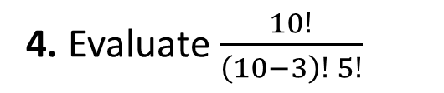
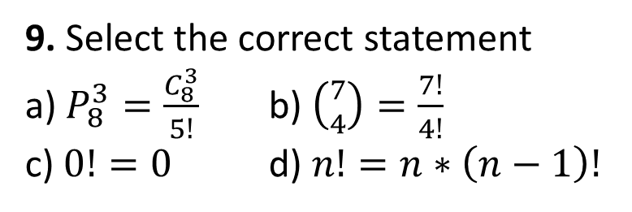
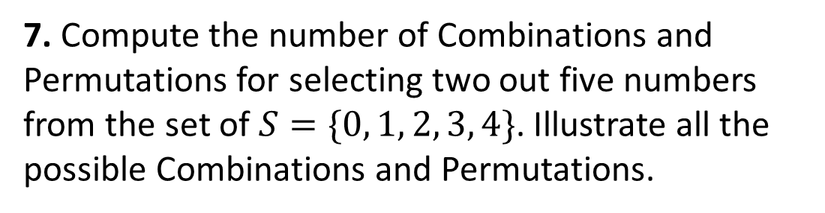

Practice Problems Part 1
9. Select the correct statement
a) $P_{8}^{3}=\frac{C_{8}^{3}}{5!}$ b) $\left({7 \atop 4}\right)=\frac{7!}{4!}$
c) $0!=0$ d) $n!=n∗\left(n−1\right)!$
4. Evaluate $\frac{10!}{\left(10−3\right)! 5!}$
10. Suppose a computer password consists of six letters and/or digits.
How many different passwords are possible if upper-case letters treated different from lower-case letters?
5. Given five women and three men, how many ways can a three-member committee be selected?
6. In question 5, how many of the three-member committee have exactly two women?
7. Compute the number of Combinations and Permutations for selecting two out five numbers from the set of $S=\{0, 1, 2, 3, 4\}$. Illustrate all the possible Combinations and Permutations.
8. Evaluate $\left({7 \atop 3}\right)$
Notes:
Answers are provided in Ch3 Practice Problem Solutions
More examples can be find on
http://staff.argyll.epsb.ca/jreed/math30p/perms_combs/fcp.htm
https://faculty.elgin.edu/dkernler/statistics/ch05/5-5.html
http://www.wtamu.edu/academic/anns/mps/math/mathlab/col_algebra/col_alg_tut55_count.htm

